Slide 1

PRAGUE DEPARTMENT PROJECT
CREATED BY: Michal Uhrinek

Slide 2


MOTIVATION
- Wrongfully blamed
- felt bad (change career) where do I stand
- where do I suck?

Slide 3

WHAT IS THIS SYSTEM?
It is a system that easily collects data, tracks data and provide insights into my performance so that I can easily tell exactly where I stand in my progresss.
researched all emails with rejected tasks
put it into categories
design a user-friendly checklist
compile all the data
summarise and present it in crayons

Slide 4




HOW DOES THE SYSTEM SOLVE THE PROBLEM?
It exactly pinpoints strenghts and weaknesses
- so you know exactly what you need to get help with.
- easily track progress.
- easily track the quality of training
= no need to change career yet!!!
= can not be wrongfully blamed

Slide 5
SO HOW DOES IT WORK?

Slide 6

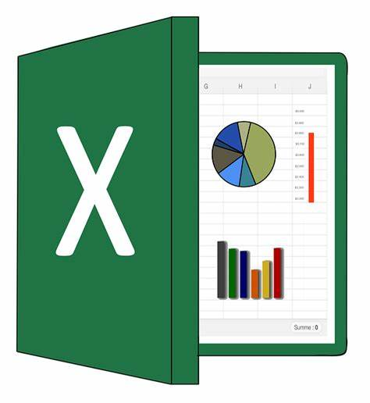





DATA FLOW
Daily data collection on personal level
Elan
In the end of the week Mike will take data to process them.
Why should we do it?
We can monitor the department
or employee progress.
If anyone need extra training and where?
track KPI of an employee
Its easy to use, access, fast, no training required
Does not require additional resources
If Prague wants to call on us about some mistakes, we can show them our stats as a proof.
Michal
Nasrul
Monthly stats for each person
Team monthly stats
Renee

Slide 7
PROPOSAL
- COLLECT DATA FROM ENTIRE DEPARTMENT FOR 1 TO 4 WEEKS
BENEFITS
- Able to track the level of accuracy of each employee and a
department as a whole.
- Able to identify, tabulate and track each members strengts and weaknesses.
- peer mentoring
- professional development

Slide 8
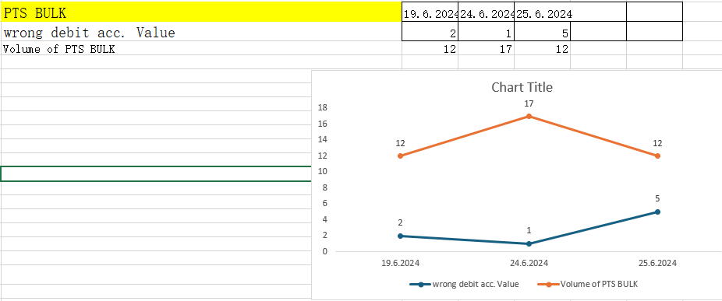
IS THERE A WAY TO TRACK PTS CURR OR SPECIFIC ERROR OVER TIME ?
Yes, it is and here you can trace any type of error or volume or application like PTS CURR over time.

Slide 9


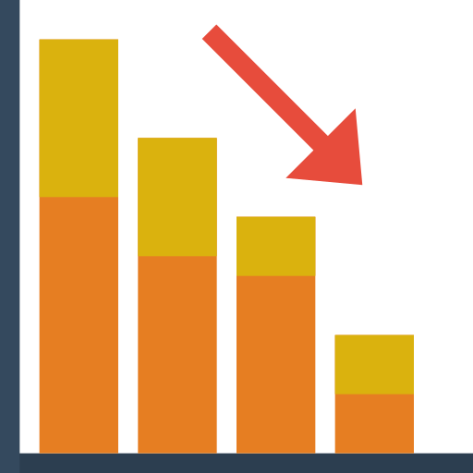
WHAT WILL HAPPEN IF WE DON’T IMPLEMENT THIS SYSTEM?
Efficiency of department
is not fully optimised
hard to track progress and
pinpoint strenghts and weaknesses
professional development not properly tracked

Slide 10
THANK YOU

Slide 11
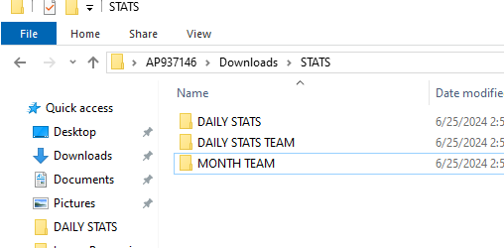
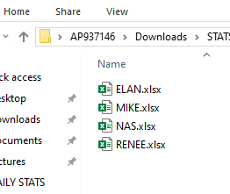
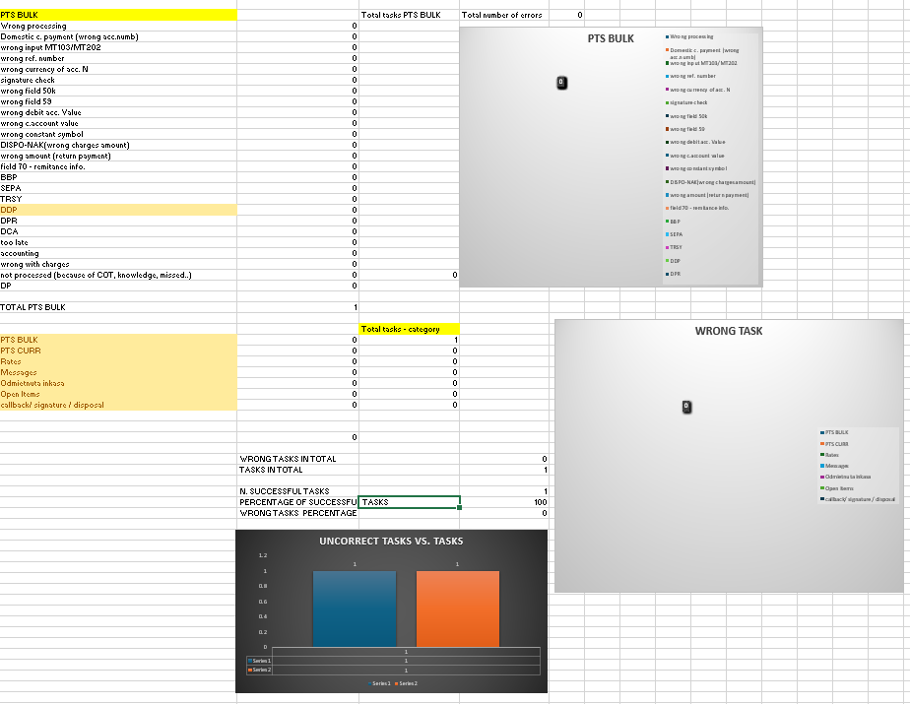
FILE ORGANIZATION
In the beginning of the shift employee just copy and paste a excel sheet of himself.
Then he/she continue inputting data in it.
This way we have new sheets per day per person.

Slide 12
WHY DO WE NEED TO KEEP TRACK OF VOLUME FOR DIFFERENT TASKS?
Imagine scenario:
Monday Tuesday Wednesday Thursday Friday
Task volume: 10 50 500 50 120
Error: 1 3 4 5 6

Slide 13
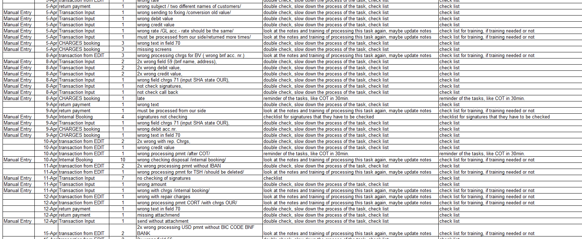
DATA BEFORE

Slide 14
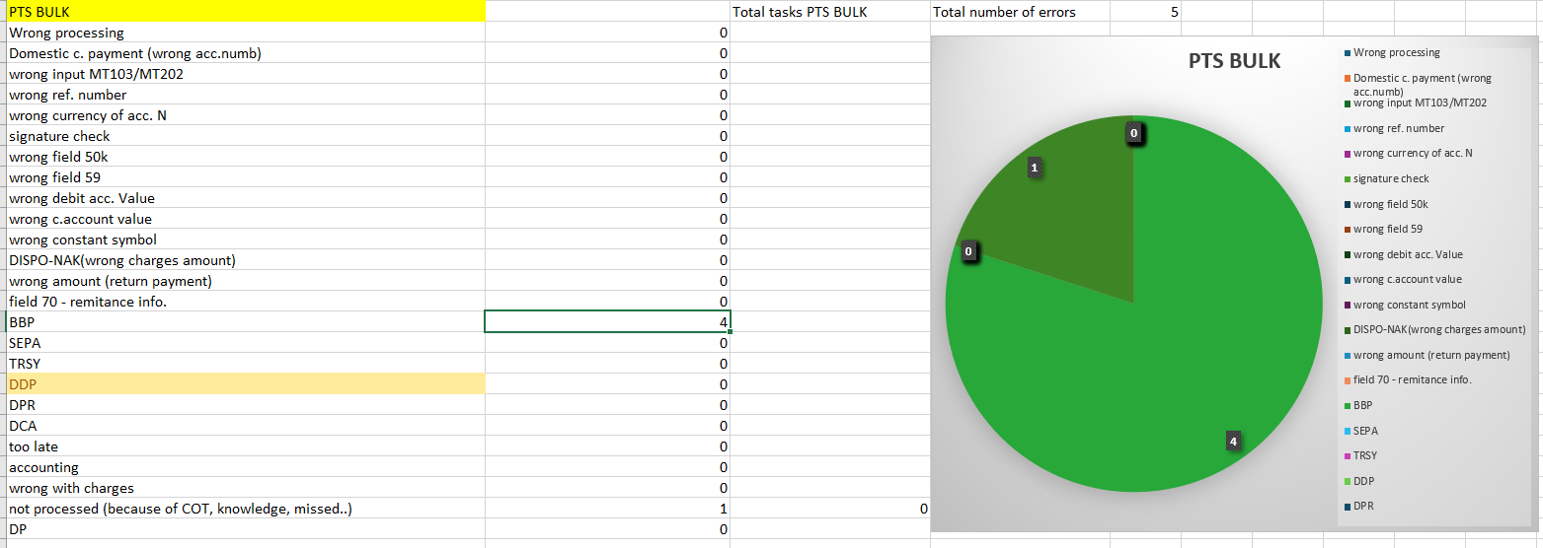
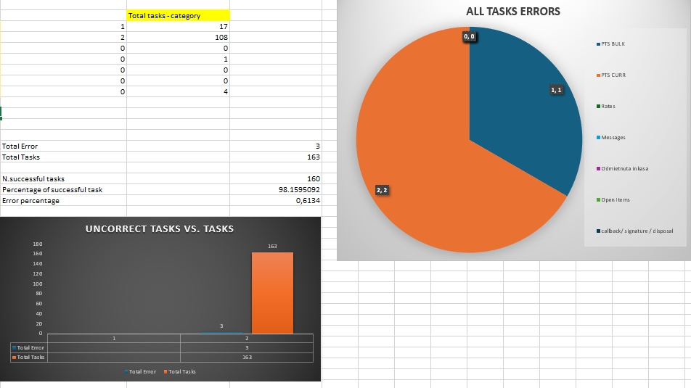
DATA NOW

